Slide 1

ESTIMATION OF TIME DEATH
BY – THE TECHNOS

Slide 2

Estimating the time of death for the deceased is something else that the pathologist will have to do during the course of his autopsy procedures. In addition to this he or she may be called upon at the scene of a crime whilst carrying out their external examinations to try and judge - or best guess - when the victim died.

Slide 3

We have coded the method of estimating the time of death of a corse by using NEWTON’S LAW OF COOLING which implies that
“Newton's Law of Cooling. Newton's Law of Cooling states that the rate of change of the temperature of an object is proportional to the difference between its own temperature and the ambient temperature”

Slide 4
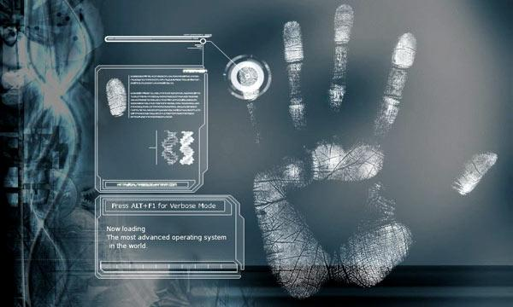
Code
#include<stdio.h>
#include<math.h>
#include<stdlib.h>
#define K 2.303
struct input
{
float initialtemperature,finaltemperature;
struct time
{
int hours;
int minutes;
}time1,time2,differencetime,timeofdeath,tod;
}input1;
void display(intput1,input1,input1,input1);

Slide 5

int main()
{
float a,b,c;
float roomtemp,normal=98.6;
int t1=0,t2,t3;
float c1,c2,e;
FILE *fp;
fp=fopen("Post.txt","w");
puts("Enter temperature 1 in Farenheit");
scanf("%f",&input1.initialtemperature);
if(input1.initialtemperature > 98.6)
{
exit(1);
}
puts("Enter time of initial temperature");
scanf("%d%d",&input1.time1.hours,&input1.time1.minutes);
if(input1.time1.minutes>=60)
{
puts("Enter Minutes less than or Equal to 60(Exiting Program...)");
exit(0);
}
fprintf(fp,"INITIAL TEMPERATURE:%f\n",input1.initialtemperature);
fprintf(fp,"INITIAL TEMPERATURE TIME:%dhrs %d min\n",input1.time1.hours,input1.time1.minutes);
puts("Enter temperature 2 in Farenheit");
scanf("%f",&input1.finaltemperature);
fprintf(fp,"FINAL TEMPERATURE:%f\n",input1.finaltemperature);
puts("Enter time of 2nd temperature recorded");
scanf("%d%d",&input1.time2.hours,&input1.time2.minutes);
if(input1.time1.minutes>=60)
{
puts("Enter Minutes less than or Equal to 60(Exiting Program...)");
exit(0);
}

Slide 6
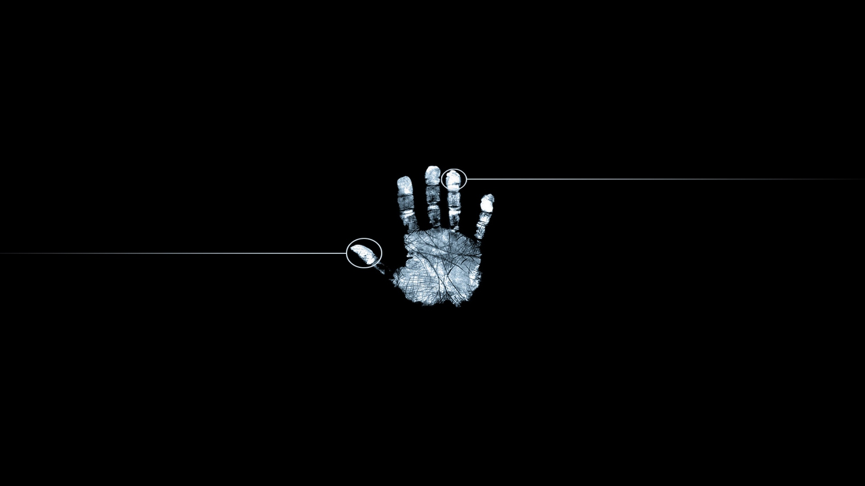
fprintf(fp,"FINAL TEMPERATURE TIME:%dhrs %d min\n",input1.time2.hours,input1.time2.minutes);
puts("Enter Room Temperature ");
scanf("%f",&roomtemp);
input1.differencetime.hours = input1.time2.hours - input1.time1.hours;
input1.differencetime.minutes = input1.time2.minutes - input1.time1.minutes;
if(input1.differencetime.minutes>60)
{
input1.differencetime.hours++;
}
t2=(input1.differencetime.hours*60);
t2=t2+input1.differencetime.minutes;
printf("%d is The Time Difference in Minutes Between Initial and Final Recording",t2);
fprintf(fp,"%d is The Time Difference in Minutes Between Initial and Final Recording\n",t2);
a=input1.initialtemperature-roomtemp;
b=input1.finaltemperature-roomtemp;
c=(1/t2)*(log(b/a)*K);
t3=-t2*(log((normal-roomtemp)/(a)))*K/((log(a/b)*K));
input1.timeofdeath.hours=-(t3/60);
input1.timeofdeath.minutes=-(t3%60);
input1.tod.hours=input1.time1.hours-(input1.timeofdeath.hours);
input1.tod.minutes=60-(input1.timeofdeath.minutes);
if( input1.tod.minutes<60)
{
input1.tod.hours--;
}
if( input1.tod.minutes>60 && input1.tod.minutes<0 )
{
input1.tod.hours++;
input1.tod.minutes=(input1.timeofdeath.minutes)-60;
}

Slide 7
display(input1.tod.hours,input1.tod.minutes ,input1.timeofdeath.hours,input1.timeofdeath.minutes);
fprintf(fp,"Time of Death %d:%d \n The Victim died %d hrs %d Minutes before the Initial Temperature was recorded",input1.tod.hours,input1.tod.minutes ,input1.timeofdeath.hours,input1.timeofdeath.minutes);
fclose(fp);
return 0;
}
void display(input1 x,input1 y,input1 ab,input1 ba)
{
printf("\nTime of Death %d : %d \n The Victim died %d hrs %d Minutes before the Initial Temperature was recorded ",x,y,ab,ba);
}

Slide 8

ADVANTAGES
An accurate estimation of the time of death can lead to discovering the identity of the assailant.
In criminal cases, it can eliminate some suspects while focusing attention on others.
For example, a husband says that he left for a business meeting at 2 P.M. and returned at 8 P.M. to find his wife dead. He says that he was home all morning and that she was alive and well when he left. If the ME determines the time of death was between 10 A.M. and noon, the husband has a great deal of explaining to do. On the other hand, if the estimation reveals that the death occurred between 4 and 6 P.M., and the husband has a reliable alibi for that time period, the investigation will move in a different direction.

Slide 9

The time of death is not confined to criminal investigations; it can also come into play in civil situations. Insurance payments may depend upon whether the insured individual were alive at the time the policy went into effect or if he died before the policy expired.

Slide 10

Since death is certain and the time of death is uncertain, what is the most important thing?

Slide 11
DONE BY PIYUSH KUMAR MALOO SHAIK GOLAM KIBRIYA VIGNESH S SIVA SURIYA G

